Slide 1
MUNICIPAL SOLID WASTE MANAGEMENT 18CEO306T

Slide 2
TOPICS – UNIT 1
Introduction and objectives of solid waste management
Sources of Solid wastes
Classifications of solid wasters-sources & Types
Characteristics of waste- physical, Chemical and Biological
Characteristics of wastes – Problem solving
Salient features of Indian legislations on management and handling of municipal solid wastes
Public health effect – Environmental effect
Methods of sampling and characterization
Tutorial 1: Identify the effects of solid waste.
Tutorial 2: Case Study: Status of Waste Generation in Bangalore
Public awareness and practices in waste management
Factors affecting SWM system
Progress of MSW Management in INDIA
Solid waste Management System

Slide 3
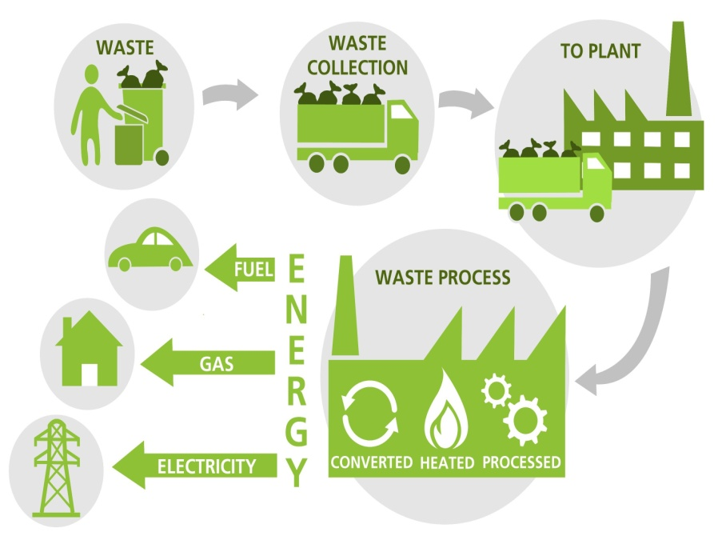
INTRODUCTION – SOLIDWASTE MANAGEMENT
Introduction – Solid waste management: Increased urban population has enhanced the demands for consumables resulting in larger generation of wastes both in volume as well as per capita with less recovery and reuse of solid wastes.
This increasing volume of waste, demands an effective waste management system in terms of collection capacity, Treatment, disposal and after care.
Thus the necessity for greater investments of human, technological and financial resources for waste management is pertinent in order to maintain a cleaner and sustainable environment.
SOLID WASTE MANAGEMENT/ PROCESS

Slide 4
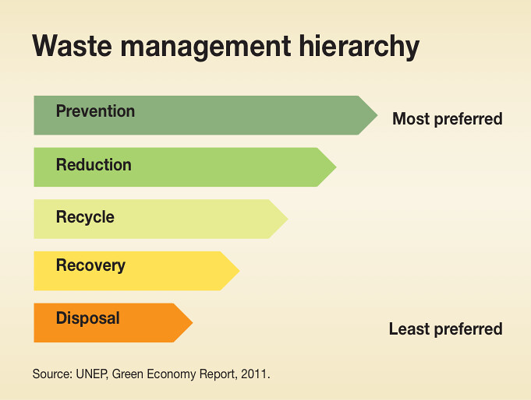
INTRODUCTION
Waste management strategies that focus on source reduction, resource recovery and rescue have proven to be more cost effective over the long run, and they are less damaging to the environment simply because they prevent or minimize waste generation at the source.
Hierarchy of waste management: Waste management strategies based on prevention strive to eradicate disadvantages because they eliminate waste at source.
Hierarchy based on long-term liabilities or risks associated with waste management. This includes
1. Prevention
2. Recycling / Resource recovery / Waste to energy
3. Treatment
4. Disposal

Slide 5
INTRODUCTION
Prevention: This strategy prevents wastes from ever being formed in the first place
Recycling / Resource recovery / Waste to energy: – Recycling and reuse of materials, the recovery of certain wastes for reuse, and the conversion of certain types waste into useful energy such as heat, electricity, and hot water are strategies which recover and offset costs for overall waste management.
Treatment: When wastes cannot be prevented or minimized through reuse or recycling, then we need to pursue strategies aimed at reducing volumes and/or toxicity. Treatment technologies are process that focus on stabilization of wastes, reducing toxicity, reducing volume before ultimate disposal, or in some cases creating limited-use by-products.

Slide 6
INTRODUCTION
Disposal : The only other strategy available is disposal.
Waste disposal practices are integrated into the environmental management strategies of all municipalities, are integral to most manufacturing operations, and quite often are among the highest direct cost components.

Slide 7
OBJECTIVES – SOLID WASTE MANAGEMENT
Objectives:
1. Minimize waste generation,
2. Maximize the collection efficiency of waste,
3. Reduce the volume of waste requiring disposal and maximize the economic value of waste,
4. Develop and adopt environmental sustainable treatment and disposal methods.
In general the objective adopted by the working group of Solid waste management is to improve the cleanliness of the city through increase of collection and disposal of waste
To create sustainable income generating activities for Community Based Organization and small trade enterprises involved in waste collection and recycling, and reduce the waste volumes by encouraging recycling, reuse and composting.

Slide 8
SOURCES OF SOLID WASTES
Solid wastes are the organic and inorganic materials such as product packaging, grass clippings, furniture, clothing, bottles, kitchen refuse, paper appliances, paint cans, batteries and etc., produced in a society, which do not generally carry any value to the first users.
Solid wastes are classified on the basis of source of generation and type.

Slide 9
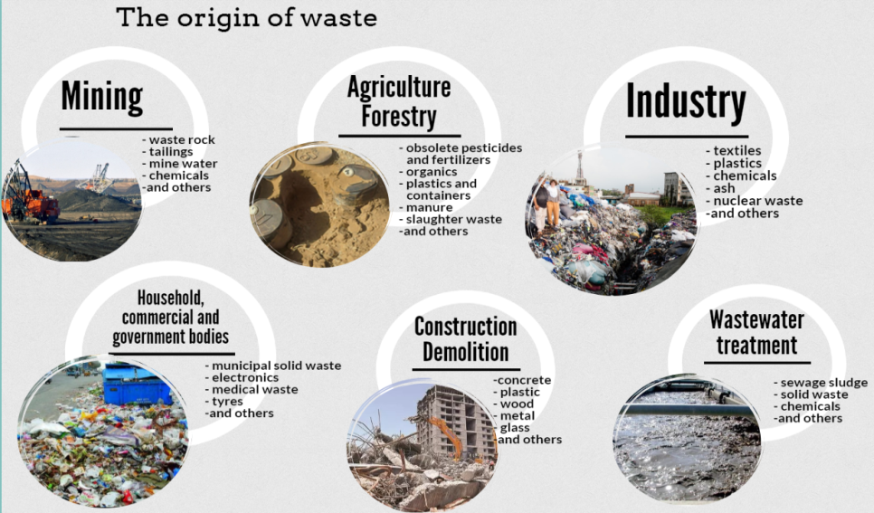
Source based

Slide 10
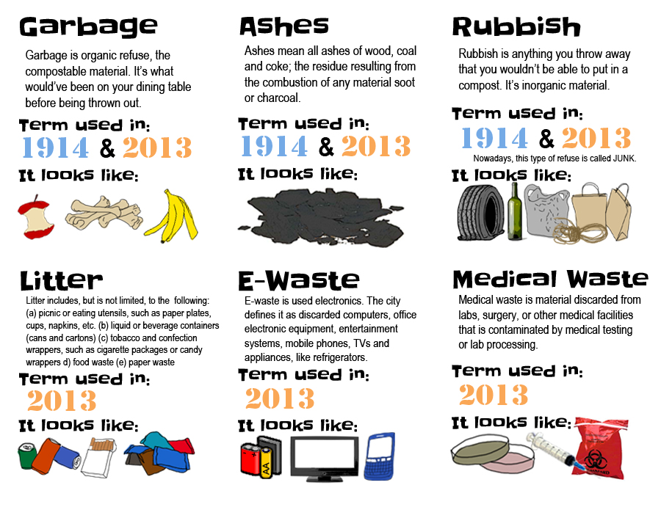
Type based

Slide 11
SOURCES OF SOLID WASTES
Source based
Residential | This refers to wastes from dwellings, apartments, etc., and consists of leftover food, vegetable peels...
Commercial | This refers to wastes consisting of leftover food, glasses, metals, ashes.. Generated from stores, restaurants, markets, hotels..
Institutional | This mainly consists of paper, plastic, glasses etc generated from educational, administrative and public buildings such as schools, colleges, offices...
Municipal | This includes dust, building debris, treatment plan residual sludge and etc., generated from various municipal activities like construction, demolition and landscaping
Industrial | This mainly consists of process wastes, ashes, hazardous wastes and etc due to industrial activities
Agricultural | This mainly consists of spoiled food grains and vegetables, agricultural remains, litter and etc generated from fields, orchards and farms etc.
Open areas | This includes wastes from areas such as streets, parks, vacant lots and etc..

Slide 12
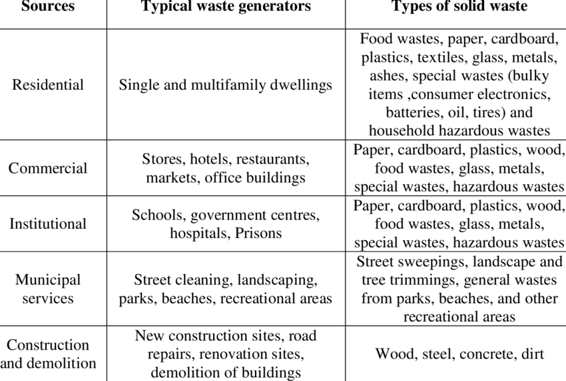
SOURCES OF SOLID WASTES/ SOURCE BASED

Slide 13
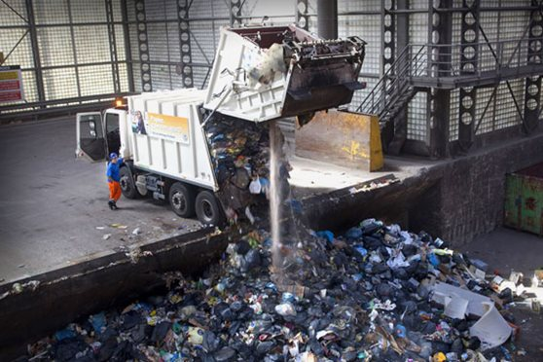
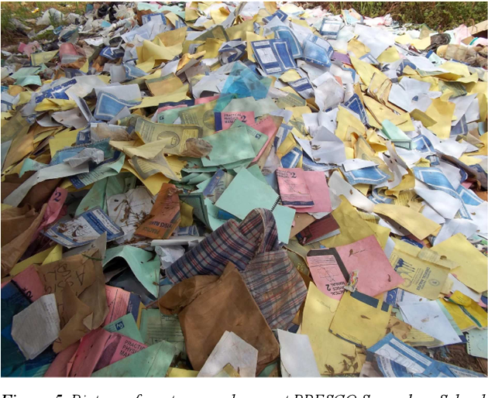
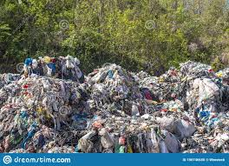
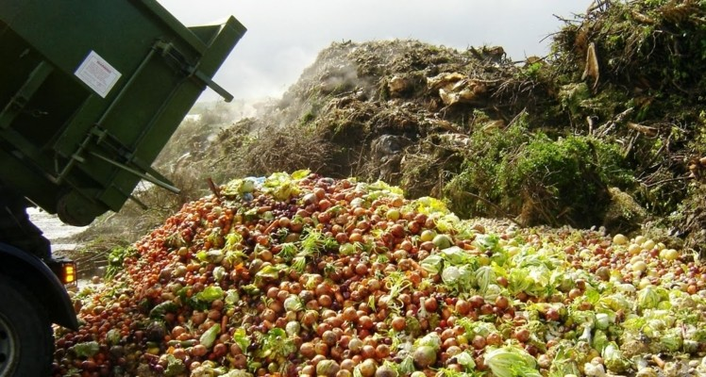
SOURCE BASED CLASSIFICATION
Fig: Commercial and Industrial Waste
Fig: Institutional Waste
Fig: Municipal Waste
Fig: Agricultural Waste

Slide 14
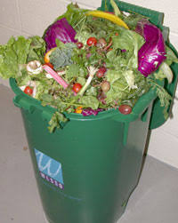
SOURCE-BASED CLASSIFICATION
Residential: This refers to wastes from dwellings, apartments, etc., and consists of leftover food, vegetable peels, plastic, clothes, ashes, etc.
Commercial: This refers to wastes consisting of leftover food, glasses, metals, ashes, etc., generated from stores, restaurants, markets, hotels, motels, auto-repair shops, medical facilities, etc.
Institutional: This mainly consists of paper, plastic, glasses, etc., generated from educational, administrative and public buildings such as schools, colleges, offices, prisons, etc.
Fig: Residential Waste

Slide 15
SOURCE-BASED CLASSIFICATION
Municipal: This includes dust, leafy matter, building debris, treatment plant residual sludge, etc., generated from various municipal activities like construction and demolition, street cleaning, landscaping, etc.
Industrial: This mainly consists of process wastes, ashes, demolition and construction wastes, hazardous wastes, etc., due to industrial activities.
Agricultural: This mainly consists of spoiled food grains and vegetables, agricultural remains, litter, etc., generated from fields, orchards, vineyards, farms, etc.
Open areas: this includes wastes from areas such as Streets, alleys, parks, vacant lots, playgrounds, beaches, highways, recreational areas, etc.

Slide 16
SOURCES OF SOLID WASTES

Slide 17

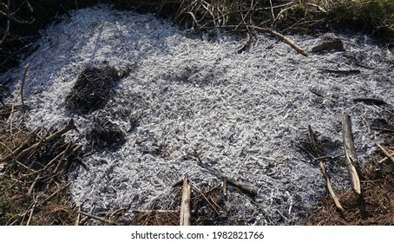
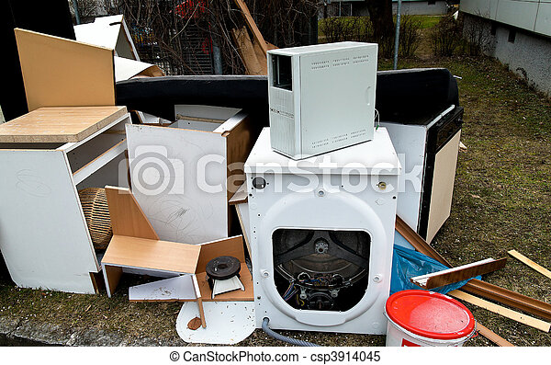
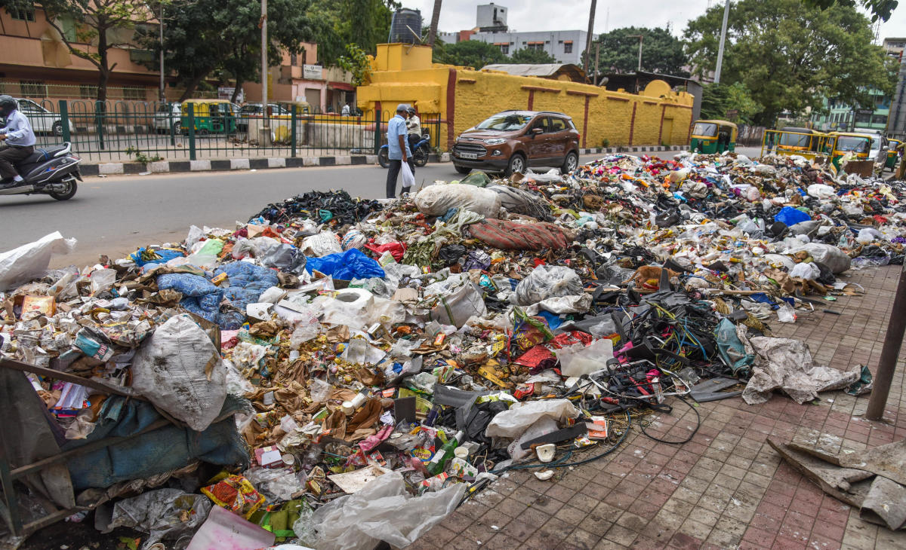
TYPE BASED CLASSIFICATION
Fig: Degradable and Non Bio Waste
Fig: Ashes and residue Waste
Fig: Bulky Waste
Fig: Street Waste

Slide 18
TYPE-BASED CLASSIFICATION
Classification of wastes based on types, i.e., physical, chemical, and biological characteristics of wastes
Garbage: This refers to animal and vegetable wastes resulting from the handling, sale, storage, preparation, cooking and serving of food.
Ashes and residues: These are substances remaining from the burning of wood, coal, charcoal, coke and other combustible materials for cooking and heating in houses, institutions and small industrial establishments.
Combustible and non-combustible wastes: These consist of wastes generated from households, institutions, commercial activities, etc.,

Slide 19
Bulky wastes: These include large household appliances such as refrigerators, washing machines, furniture, crates, vehicle parts, tyres, wood, trees and branches.
Street wastes: These refer to wastes that are collected from streets, walkways, alleys, parks and vacant plots, and include paper, cardboard, plastics, dirt, leaves and other vegetable matter.
Biodegradable and non-biodegradable wastes: Biodegradable wastes mainly refer to substances consisting of organic matter such as leftover food, vegetable and fruit peels, paper, textile, wood, etc., generated from various household and industrial activities.

Slide 20
TYPE-BASED CLASSIFICATION
Dead animals: With regard to municipal wastes, dead animals are those that die naturally or are accidentally killed on the road. Note that this category does not include carcasses and animal parts from slaughter-houses
Abandoned vehicles: This category includes automobiles, trucks and trailers that are abandoned on streets and other public places.
Construction and demolition wastes: These are wastes generated as a result of construction, refurbishment, repair and demolition of houses, commercial buildings and other structures.
Farm wastes: These wastes result from diverse agricultural activities such as planting, harvesting, production of milk, rearing of animals for slaughter and the operation of feedlots.

Slide 21
TYPE-BASED CLASSIFICATION
Hazardous wastes: Hazardous wastes are those defined as wastes of industrial, institutional or consumer origin that are potentially dangerous either immediately or over a period of time to human beings and the environment.
Sewage wastes: The solid by-products of sewage treatment are classified as sewage wastes. They are mostly organic and derived from the treatment of organic sludge separated from both raw and treated sewages.

Slide 22
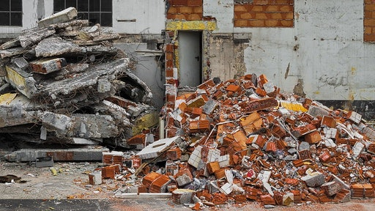
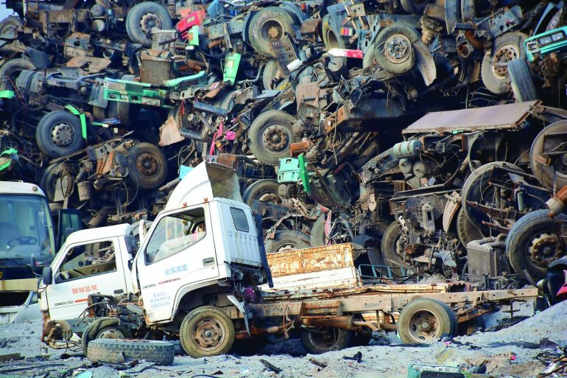
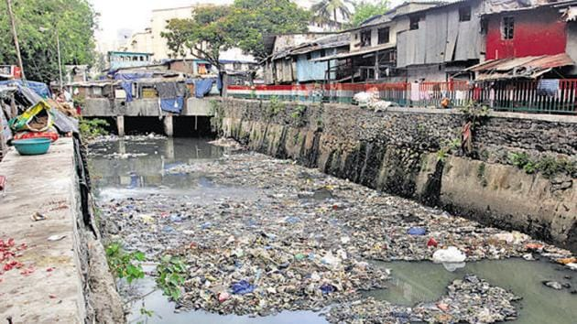
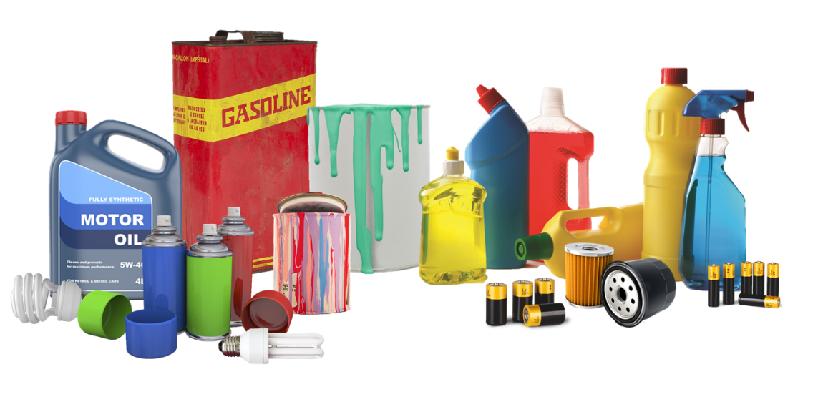
Fig: Construction Waste
Fig: Construction Waste
Fig: Abandoned Vehicle Waste
Fig: Sewage Waste
Fig: Hazardous Waste Materials

Slide 23
CHARACTERISTICS OF WASTES
Physical characteristics:
1. Analysis of particle size
2. Moisture content
3. Density of solid waste
Chemical characteristics:
1. Proximate analysis
2. Fusing point of Ash
3. Ultimate analysis of solid waste components
4. Energy content of solid waste
Biological characteristics:
1. Determination of bio-degradability of organic waste components
2. Production of odours
3. Breeding of flies

Slide 24
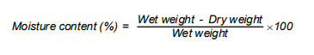
CHARACTERISTICS OF WASTES - PHYSICAL
Size: Measurement of size distribution of particles in waste stream is important because of its significance in the design of mechanical separators and shredders.
Generally, the result of size distribution analysis are expressed in the manner used for soil particle analysis.
Moisture content: Moisture content is defined as the ratio of the weight of water (wet weight – dry weight) to the total weight of the wet waste.
Moisture increases the weight of solid wastes, and thereby, the cost of collection and transport. In addition, moisture content is a critical determinant in the economic feasibility of waste treatment by incineration, because wet waste consumes energy for evaporation of water and in raising the temperature of water vapour.
A typical range of moisture content is 20 to 40% representing the extremes of wastes in an arid climate and in the wet season of a region of high precipitation. However, values greater than 40% are uncommon.

Slide 25
CHARACTERISTICS OF WASTES - PHYSICAL
Density: Density of waste i.e. its mass per unit volume ( kg/m³ ), is a critical factor in the design of a SWM system, e.g., the design of sanitary landfills, storage, types of collection and transport vehicles, etc.
In order to explain, an efficient operation of a landfill demands compaction of wastes to optimum density.
Any normal compaction equipment can achieve reduction in volume of wastes by 75%, which increases an initial density of 100 kg/m³ to 400 kg/m³ .
In other words, a waste collection vehicle can haul four times the weight of waste in its compacted state than when it is uncompacted.
A high initial density of waste precludes the achievement of a high compaction ratio and the compaction ratio achieved is no greater than 1.5:1.
Significant changes in density occur spontaneously as the waste moves from source to disposal, due to scavenging, handling, wetting and drying by the weather, vibration in the collection vehicle and decomposition.

Slide 26
CHARACTERISTICS OF WASTES - CHEMICAL
Chemical characteristics: The products of decomposition and heating values are two examples of chemical characteristics.
Ultimate analysis: This refers to an analysis of waste to determine the proportion of carbon, hydrogen, oxygen, nitrogen and sulphur, and the analysis is done to make mass balance calculation for a chemical or thermal process.
Besides, it is necessary to determine ask fraction because of its potentially harmful environmental effects, brought about by the presence of toxic metals such as cadmium, chromium, mercury, nickel, lead and zinc.
Proximate analysis: This is important in evaluating the combustion properties of wastes or a waste or refuse derived fuel.
Moisture content, which adds weight to the waste without increasing its heating value, and the evaporation of water reduces the heat released from the fuel.

Slide 27
CHARACTERISTICS OF WASTES - CHEMICAL
Lipids: This class of compounds includes fats, oils and grease, and the principal sources of lipids are garbage, cooking oils and fats.
Lipids have high heating values, about 38,000 kJ/kg (kilojoules per kilogram), which makes waste with high lipid content suitable for energy recovery. Since lipids become liquid at temperatures slightly above ambient, they add to the liquid content during waste decomposition.
Though they are biodegradable, the rate of biodegradation is relatively slow because lipids have a low solubility in water.
Natural fibres: These are found in paper products, food and yard wastes and include the natural compounds, cellulose and lignin, that are resistant to biodegradation. (Note that paper is almost 100% cellulose, cotton over 95% and wood products over 40%.)
Because they are a highly combustible solid waste, having a high proportion of paper and wood products, they are suitable for incineration. Calorific values of oven-dried paper products are in the range of 12,000 -18,000 kJ/kg and of wood about 20,000 kJ/kg, i.e., about half that for fuel oil, which is 44,200 kJ/kg.

Slide 28
CHARACTERISTICS OF WASTES - BIOLOGICAL
Biodegradability
Organic fraction often equated with the volatile solids content of the waste. However not all organic materials are easily degradable,
Degradation produces odours
Hydrogen sulphide H₂S (rotten eggs)
Methyl mercaptans
Aminobutyric acid
Methane is odourless
Attract flies, vermin, rodents.

Slide 29
PUBLIC HEALTH EFFECT
Public health effect: The volume of waste is increasing rapidly as a result of increasing population and improving economic conditions in various localities. This increased volume of wastes is posing serious problems due to insufficient workforce and other constraints in disposing of it properly. What are the consequences of improper management and handling of wastes? Consider the following:
1. Disease vectors and pathways
2. Flies
3. Mosquitoes
4. Roaches
5. Rodents
6. Occupational hazards
7. Animals

Slide 30
PUBLIC HEALTH EFFECT
1. Disease vectors and pathways: Wastes dumped indiscriminately provide the food and environment for thriving populations of vermin, which are the agents of various diseases.
The pathways of pathogen transmission from wastes to humans are mostly indirect through insects – flies, mosquitoes, roaches and animals – rodents and pigs.
Diseases become a public health problem when they are present in the human and animal population of surrounding communities, or if a carrier transmits the etiological agent from host to receptor.
2. Flies : Most common in this category is the housefly, which transmits typhoid, salmonellosis, gastro-enteritis and dysentery. Flies have a flight range of about 10 km, and therefore, they are able to spread their influence over a relatively wide area.
The four stages in their life-cycle are egg, larva, pupa and adult. Eggs are deposited in the warm, moist environment of decomposing food wastes.
When they hatch, the larvae feed on the organic material, until certain maturity is reached, at which time they migrate from the waste to the soil of other dry loose material before being transformed into pupae.
The pupae are inactive until the adult-fly emerges. The migration of larvae within 4 to 10 days provides the clue to an effective control measure, necessitating the removal of waste before migration of larvae.

Slide 31
PUBLIC HEALTH EFFECT
3. Mosquitoes: They transmit diseases such as malaria, filaria and dengue fever. Since they breed in stagnant water, control measures should centre on the elimination of breeding places such as tins, cans, tyres, etc. Proper sanitary practices and general cleanliness in the community help eliminate the mosquito problems caused by the mismanagement of solid waste.
4. Roaches: These cause infection by physical contact and can transmit typhoid, cholera and amoebiasis. The problems of roaches are associated with the poor storage of solid waste.
5. Rodents: Rodents (rats) develops in uncontrolled deposits of solid wastes, which provide a source of food as well as shelter. They are responsible for the spread of diseases such as plague, murine typhus, leptospirosis, histoplasmosis, rat bite fever, dalmonelosis, trichinosis, etc. The fleas, which rats carry, also cause many diseases. This problem is associated not only with open dumping but also poor sanitation.

Slide 32
PUBLIC HEALTH EFFECT
6. Occupational hazards: Workers handling wastes are at risk of accidents related to the nature of material and lack of safety precautions. The sharp edges of glass and metal and poorly constructed storage containers may inflict injuries to workers. It is, therefore, necessary for waste handlers to wear gloves, masks and be vaccinated.
7. Animals: Apart from rodents, some animals (e.g., dogs, cats, pigs, etc.) also act as carriers of disease. For example, pigs are involved in the spread of diseases like trichinosis, cysticerosis and toxoplasmosis, which are transmitted through infected pork, eaten either in raw state or improperly cooked. Solid wastes, when fed to pigs, should be properly treated (cooked at 100 C for at least 50 minutes with suitable equipment).

Slide 33
ENVIRONMENTAL EFFECT
Environmental effect: inadequate and improper waste management causes adverse environmental effects such as the following:
1. Air pollution:
2. Water and land pollution
3. Visual pollution
4. Noise pollution
5. Odour pollution
6. Explosion hazards

Slide 34
ENVIRONMENTAL EFFECT
1. Air pollution: Burning of solid wastes in open dumps or in improperly designed incinerators emit pollutants (gaseous and particulate matters) to the atmosphere.
Studies show that the environmental consequences of open burning are greater than incinerators, especially with respect to aldehydes and particulates. Emissions from an uncontrolled incinerator system include particulate matter, sulphur oxides, nitrogen oxides, hydrogen chloride, carbon monoxide, lead and mercury.
2. Water and land pollution: Water pollution results from dumping in open areas and storm water drains, and improper design, construction and/or operation of a sanitary landfill. Control of infiltration from rainfall and surface runoff is essential in order to minimise the production of leachate.
Pollution of groundwater can occur as a result of: the flow of groundwater through deposits of solid waste at landfill sites; percolation of rainfall or irrigation waters from solid wastes to the water table; diffusion and collection of gases generated by the decomposition of solid wastes.

Slide 35
ENVIRONMENTAL EFFECT
3. Visual pollution: The aesthetic sensibility is offended by the unsightliness of piles of wastes on the roadside. The situation is made worse by the presence of scavengers rummaging in the waste. Waste carelessly and irresponsibly discarded in public thoroughfares, along roads and highways and around communal bins (i.e., makeshift containers, without lids, used for the storage of residential, commercial and institutional wastes) gives easy access to animals scavenging for food.
The solution to this social problem undoubtedly lies in the implementation of public education at all levels – primary, secondary, tertiary and adult, both short- and long-term, and in raising the status of public health workers and managers in solid waste management.
4. Noise pollution: Undesirable noise is a nuisance associated with operations at landfills, incinerators, transfer stations and sites used for recycling.
This is due to the movement of vehicles, the operation of large machines and the diverse operations at an incinerator site. The impacts of noise pollution may be reduced by careful sitting of SWM operations and by the use of noise barriers.

Slide 36
ENVIRONMENTAL EFFECT
5. Odour pollution: Obnoxious odours due to the presence of decaying organic matter are characteristic of open dumps. They arise from anaerobic decomposition processes and their major constituents are particularly offensive. Proper landfill covering eliminates this nuisance.
6. Explosion hazards: Landfill gas, which is released during anaerobic decomposition processes, contains a high proportion of methane (35 – 73%). It can migrate through the soil over a considerable distance, leaving the buildings in the vicinity of sanitary landfill sites at risk, even after the closure of landfills. Several methods are available for control of landfill gas, such as venting, flaring and the use of impermeable barriers.

Slide 37
SALIENT FEATURES OF HANDLING AND MANAGING SOLID WASTE - INDIA
The source segregation of waste has been mandated to channelize the waste by recovery, reuse and recycle.
Responsibilities of generators have been introduced to segregate waste in to three streams, Wet, Dry and domestic hazardous wastes and handover segregated wastes to authorised rag-pickers or waste collectors or local bodies.
Generator will have to pay “User fee” to waste collector and for “Spot fine” for littering and Non-segregation
The concept of partnership in Swachh Bharath has been introduced. Bulk and institutional generators, markets associations, event organizers, hotels and restaurants have been made directly responsible for segregation and sorting the waste and manage in partnership with local bodies.

Slide 38
SALIENT FEATURES OF HANDLING AND MANAGING SOLID WASTE - INDIA
All resident welfare and market associations, gated communities and institution with an area 5000 sq.m should segregate waste at source in to valuable dry waste and handover recyclable material to either the authorized waste pickers or the authorized recyclers, or to the urban local body.
The bio-degradable waste should be processed, treated and disposed of through composting or bio-methanation within the premises as far as possible. The residual waste shall be given to the waste collectors or agency as directed by the local authority.
All manufacturers of disposal products who sale or market their products in such packaging material which are non-biodegradable should put in place a system to collect back the packaging waste generated due to their production

Slide 39
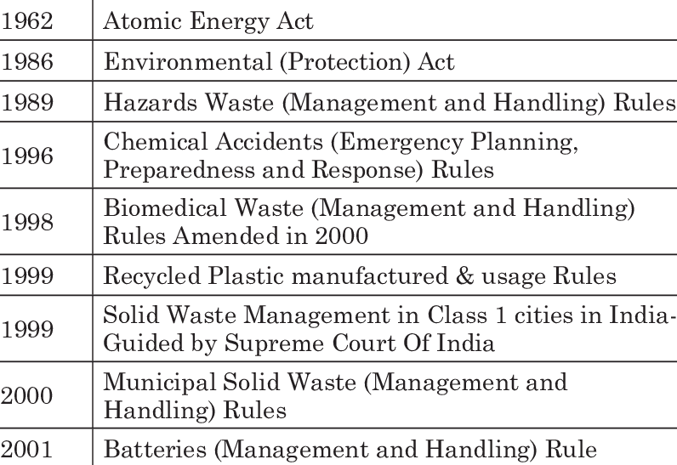
INDIAN LEGISLATION ON MANAGING AND HANDLING SOLID WASTE

Slide 40
METHODS OF SAMPLING
Sampling points should be a true representative of the given occupation sub-group. In a residential area, the sampling point should represent waste coming from at least 100 families.
If an average value of refuse characteristics for the full city is to be given, weightage factors are calculated.
The weightage factor for a specific occupation category will be the ratio of the weight of refuse produced from that occupation group divided by the total weight produced from the city.
The average values of characteristics from different occupation sub-groups are then multiplied by the weightage factor to compute the average value for the city.

Slide 41
METHODS OF SAMPLING
1. Sample Size
In studies carried out, it was found that a 100 kg sample gave as much accuracy as a 1000 kg sample.
When the collection at a point is small and a 100 kg sample cannot be obtained, smaller samples could be used for analysis.
Repetitive sampling and analysis would provide a more representative data.
At least ten grab samples should be taken from a number of points in the refuse mass both horizontally as well as vertically and then mixed to get the composite sample.

Slide 42
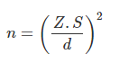
METHODS OF SAMPLING
2. Number of Samples
Carruth and Klee have given the following method for determining the number of samples:
Where -
n = number of samples required
Z = standard normal deviate for the confidence level desired
S = estimated standard deviation (transformed basis)
d = sensitivity (transformed basis)

Slide 43
METHODS OF SAMPLING
3. Physical Analysis
The sample so collected should be sorted out physically into various ingredients such as paper, glass, plastics, etc. on a sorting platform.
The individual components are separated, stored in bins and weighed. The weights are then expressed as a percent of the original sample.
4. Chemical Analysis
From the mass used for physical analysis a 500 gms sample is taken for moisture determination and heated overnight at 100°C to obtain weight loss.
This loss is expressed as a percentage of total weight.
Normally moisture content is determined as soon as the sample is collected which helps in the choice of processing and disposal methods.

Slide 44
METHODS OF SAMPLING
5. Biological Analysis
Refuse as it is produced does not normally contain human intestinal parasites.
In India and other developing countries, it is common to find refuse lying at such points where it is liable to come in contact with material containing parasites.
In cities, which do not have a sewerage system, night- soil is often deposited along with refuse which transmits parasites.

Slide 45
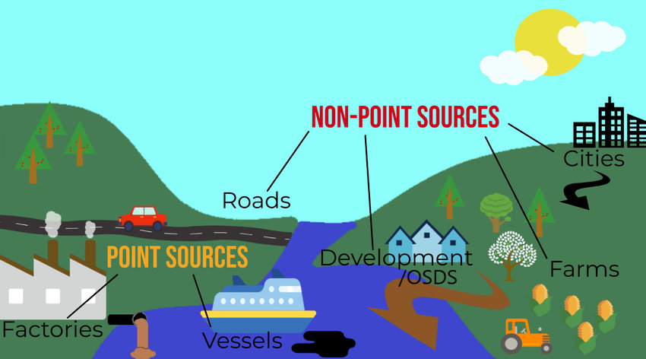
SOURCE POINTS OF SOLID WASTE
Non point Source: It is an indirect way of pollution of environment. Ex: road side waste products which are not degradable.
Point Source: When harmful substances are directly left out from places like households, commercial centers etc.
Fig: Sources of pollution

Slide 46
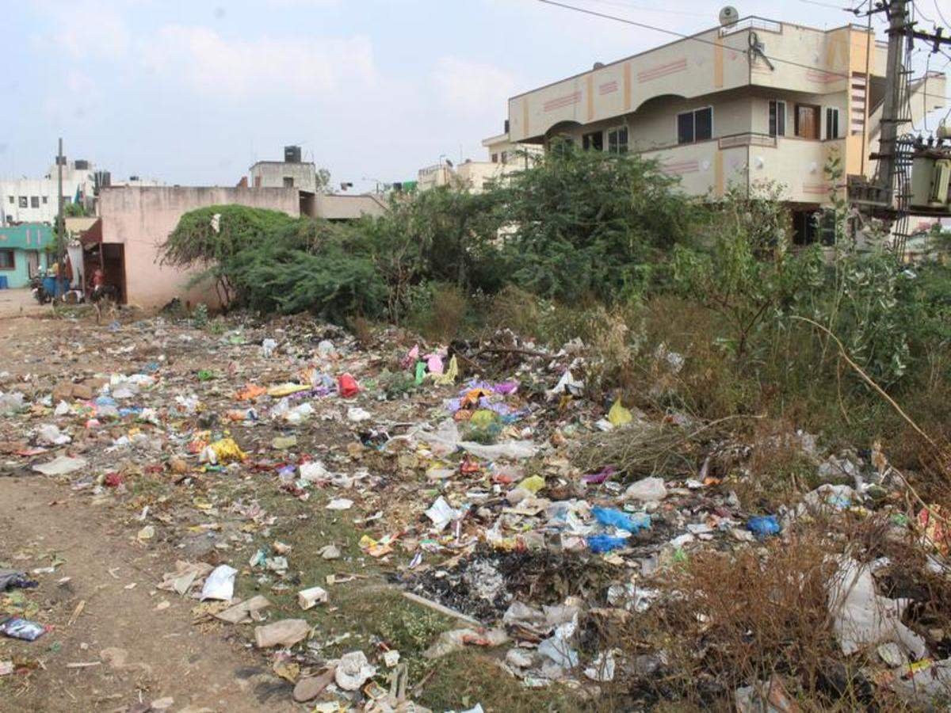
EFFECTS OF SOLID WASTE
Municipal solid wastes heap up on the roads due to improper disposal system.
People clean their own houses and litter their immediate surroundings which affects the community including themselves.
This type of dumping allows biodegradable materials to decompose under uncontrolled and unhygienic conditions.
Fig: Road side waste disposal

Slide 47
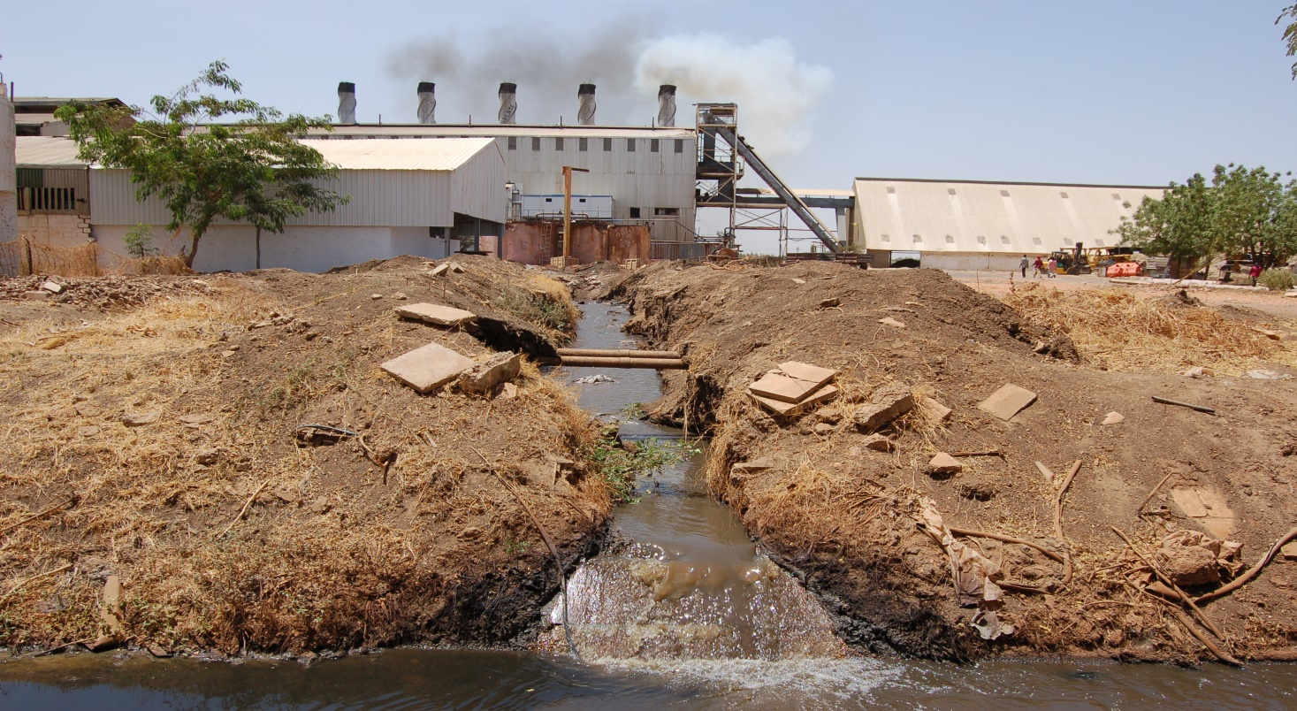
EFFECTS OF SOLID WASTE
This produces foul smell and breeds various types of insects and infectious organisms besides spoiling the aesthetics of the site.
Industrial solid wastes are sources of toxic metals and hazardous wastes, which may spread on land and can cause changes in physicochemical and biological characteristics thereby affecting productivity of soils.

Slide 48
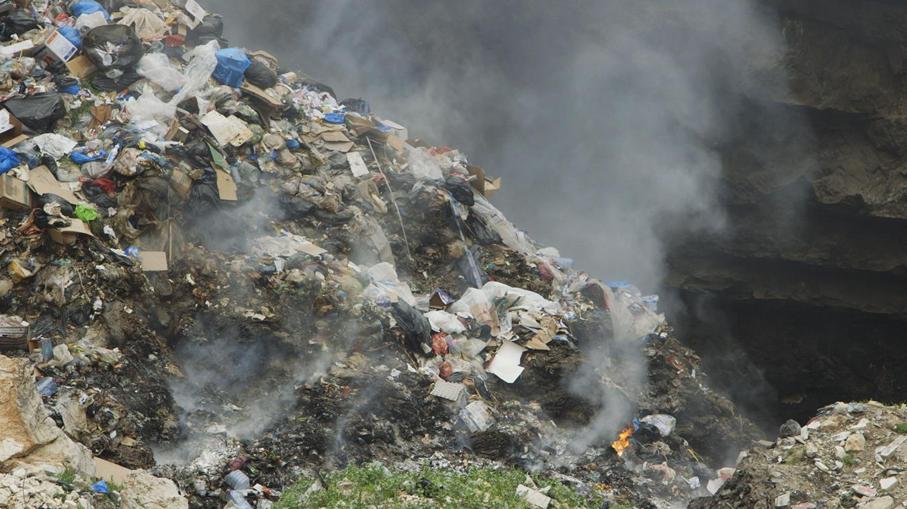
EFFECTS OF SOLID WASTE
Various types of wastes like cans, pesticides, cleaning solvents, batteries (zinc, lead or mercury), radioactive materials, plastics and e-waste are mixed up with paper, scraps and other non-toxic materials which could be recycled. Burning of some of these materials produces dioxins, furans and polychlorinated biphenyls (PCB) , which have the potential to cause various types of ailments including cancer.
Fig: Burning of Solid Waste

Slide 49
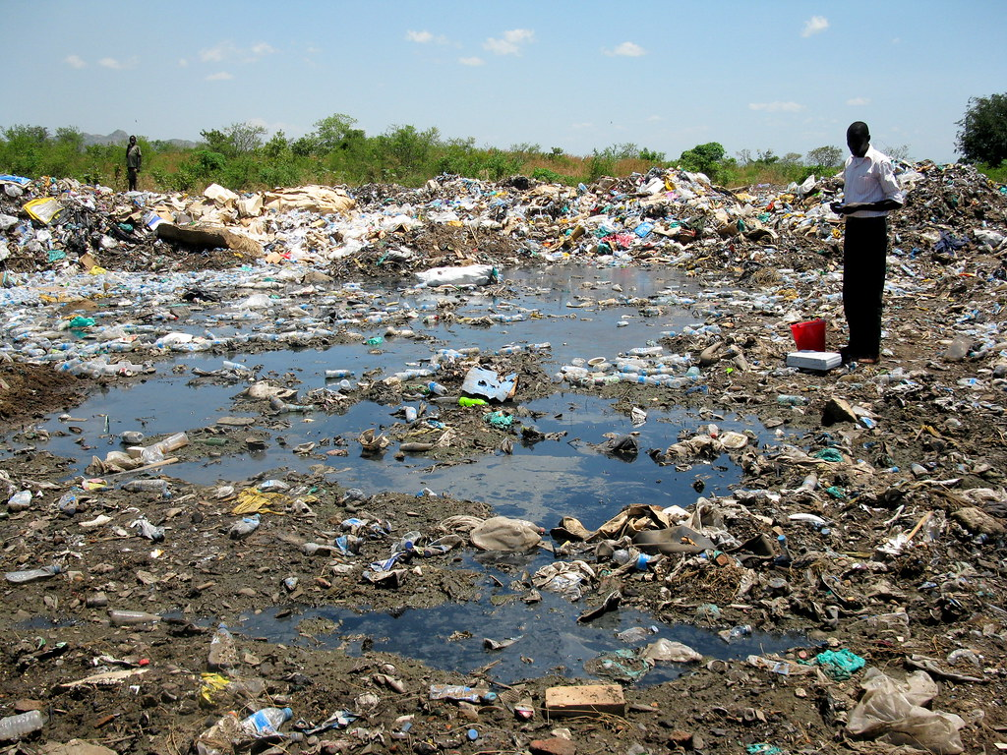
EFFECTS OF SOLID WASTE
Toxic substances may leach or percolate to contaminate the ground water. In refuse mixing, the hazardous wastes are mixed with garbage and other combustible wastes. This makes segregation and disposal all the more difficult and risky.
Fig: Groundwater contamination

Slide 50
CASE STUDY: STATUS OF WASTE GENERATION IN BANGALORE
The Bengaluru Metropolitan Area covers an area of 1258 sq. km and is the fifth largest city in India.
However, with an increased population level, rapid economic growth, and a rise in community living standard, the generation rate of MSW in metropolitan cities accelerates.
The local authorities are struggling to provide the proper solid waste management system to a satisfactory level.
Recently the authorities have taken initiatives and measures to organize the MSWM sector.

Slide 51
CASE STUDY: STATUS OF WASTE GENERATION IN BANGALORE
WASTE GENERATION:
At present, 10% of solid waste is recycled in Bengaluru and the waste generation rate is 0.4–0.6 kg/capita/day.
The proposed waste generation rate is about 0.5 kg/capita/day in Bengaluru. Since 1990, the composition of India’s urban wastes has changed drastically.
At present, the waste generation is about 5000 metric tons, and waste generation is likely to grow over the coming years.
Going by the present trend of increase in the quantity of waste, the waste quantity projected is 11175 metric tons by the year 2033

Slide 52
CASE STUDY: STATUS OF WASTE GENERATION IN BANGALORE
WASTE COMPOSITION:
The changes in the composition of MSW should form essential criteria for any waste management system.
Hence, the data available on the composition of the waste from different sources over the years have been collected and analyzed.
With the increase in urbanization and change in food habits and lifestyle, the amount of MSW has been multiplying, and there is variation in waste composition.
Variation in MSW composition from 1999 to 2013 in Bengaluru City is shown in the next figure.

Slide 53
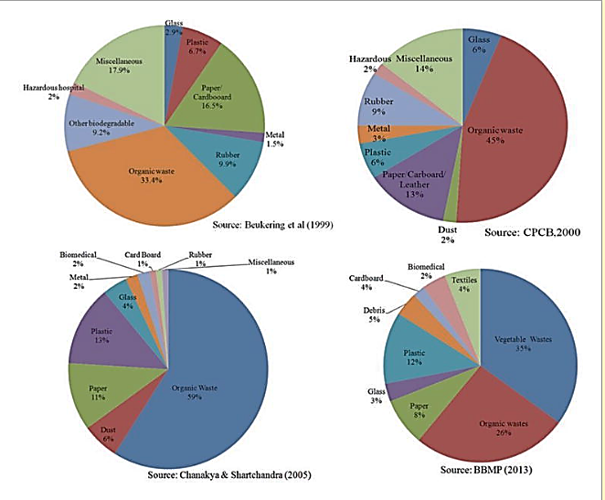
CASE STUDY: STATUS OF WASTE GENERATION IN BANGALORE
Fig: Bangalore’s urban waste composition

Slide 54
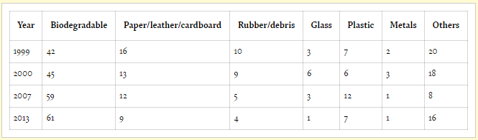
CASE STUDY: STATUS OF WASTE GENERATION IN BANGALORE
Data available on the composition of the waste from different sources over the years has been collected and analyzed. The data presented in the table was statistically analyzed to get the variations of a different type of waste in rapidly growing cities like Bangalore.
Table: Variations in MSW composition in Bangalore City from 1999 to 2013.
*All components of MSW are expressed in %.

Slide 55
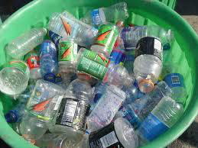

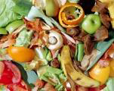
PUBLIC AWARENESS AND PRACTICES IN WASTE MANAGEMENT
Unless reduction of waste and recycling is more, environment will deteriorate putting public health at greater risk.
By segregating waste at source as an individual, a household, an institution, a shop or establishment and hand it over for collection, transport and environmentally safe disposal will automatically improve the waste management process

Slide 56
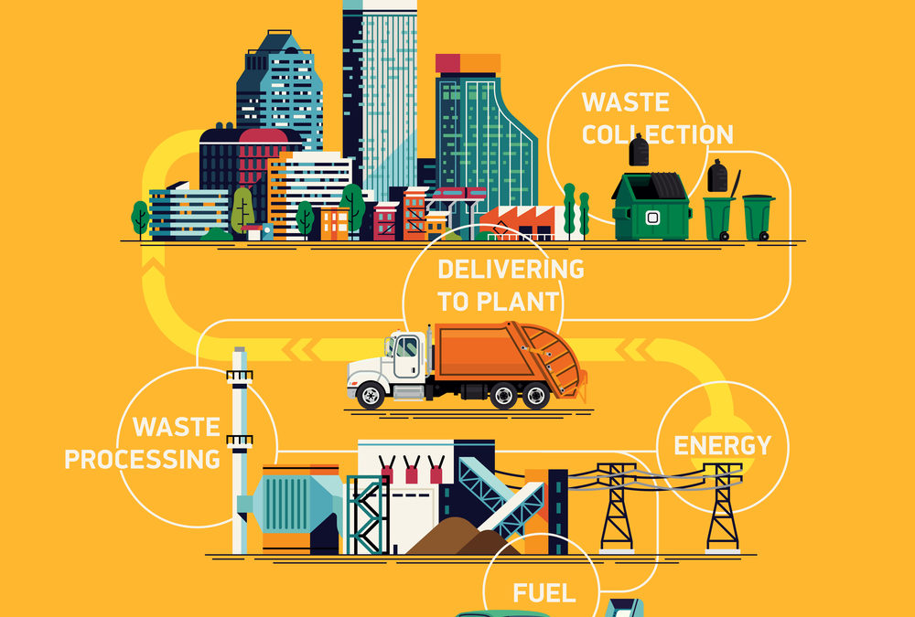
PUBLIC AWARENESS AND PRACTICES IN WASTE MANAGEMENT
Most of the materials in waste are recyclable, When waste is not segregated, it is difficult to pick out these materials for recycling.
This leads to a lot of wastage of valuable resources
Waste that is not segregated and lying in mixed up form at dumps , contaminates ground water and releases highly flammable methane an extremely potent greenhouse gas, over 20 times more effective at trapping heat in the atmosphere than carbon dioxide.

Slide 57
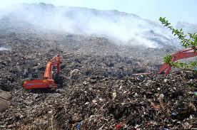
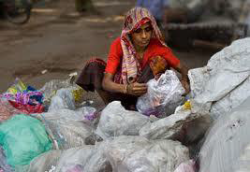
PUBLIC AWARENESS AND PRACTICES IN WASTE MANAGEMENT
Increased methane emissions enhances the greenhouse effect, trapping of heat within the Earth's atmosphere, contributing to global warming
When waste pickers and collectors handle mixed waste during collection and sorting, they get injured with cuts and abrasions. Segregation of wet and dry waste will reduce risk of injury while collecting and sorting waste.

Slide 58
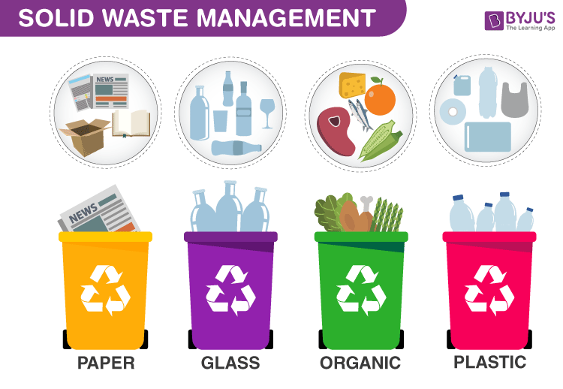
PUBLIC AWARENESS AND PRACTICES IN WASTE MANAGEMENT
Fig: Solid Waste Management

Slide 59
PUBLIC AWARENESS AND PRACTICES IN WASTE MANAGEMENT
Benefits to Society and Environment from Segregation of Waste:
Enables Easier, Cleaner, Safer and Optimal Resource Recovery
Reduces Waste that’s taken for Landfill
Reduces Time, Energy, Labor and Expense on Resource Recovery
Larger Quantity and Better Quality Resources can be Extracted from Waste
Leads to Growth and Modernization of Recycling Industry
Facilitates Conversion of Waste into Resource
Reduces Dependence on Extraction of Depleting Natural Resources
Promotes 3Rs and Environmentally Safe Disposal
Reduces Costs, Improves Earnings and Promotes Sustainability
Helps in Keeping Our Locality Clean & Green

Slide 60
PUBLIC AWARENESS AND PRACTICES IN WASTE MANAGEMENT
Initiation taken up by the municipal corporations:
Equip and train primary waste collectors to provide reliable, efficient, polite and professional solid waste collection service.
Saturate coverage of services in existing areas and extend service to uncovered areas
Carry out timely primary and secondary collection of waste to prevent accumulation and risk to public health
Organize separate collection, storage and transport of Wet and Dry Waste to facilitate optimal resource recovery

Slide 61
FACTORS AFFECTING SWM SYSTEM
Quantities and Characteristics of waste
Climate and seasonal variations
Physical characteristics of an urban area
Financial and foreign exchange constraints
Cultural constraints
Management and technical resources

Slide 62
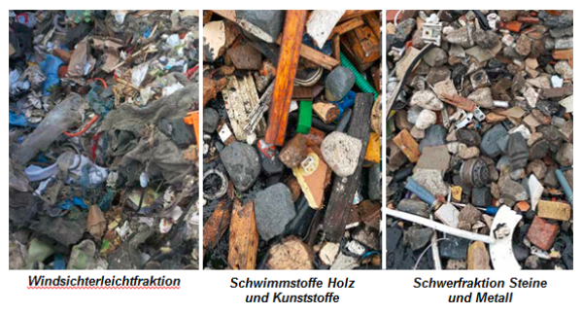
FACTORS AFFECTING SWM SYSTEM
Quantities and Characteristics of waste:
The quantities of wastes depend on the income level of a family. The quantity ranges from about 0.25 to about 2.3 kg per person per day, indicating a strong correlation between waste production and per capita income.
One of the measures of waste composition (and characteristics) is density, which ranges from 150 kg/m3 to 600 kg/m3 . Proportion of paper and packaging materials in the waste largely account for the differences. When this proportion is high, the density is low and vice versa.
Fig: Separating mixed waste

Slide 63
FACTORS AFFECTING SWM SYSTEM
Climate and seasonal variations:
In cold climates, drifting snow and frozen ground interfere with landfill operations. Tropical climates are subject to sharp seasonal variations from wet to dry season, which cause significant changes in the moisture content of solid waste.
High temperatures and humidity cause solid wastes to decompose far more rapidly than they do in colder climates. The frequency of waste collection in high temperature and humid climates should, therefore, be higher than that in cold climates.
In sub-tropical or desert climate, there is no significant variation in moisture content of wastes (due to low rainfall) and low production of leachate from sanitary landfill.

Slide 64
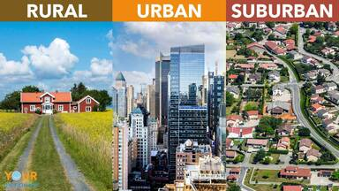
FACTORS AFFECTING SWM SYSTEM
Physical characteristics of an urban area:
In urban areas (i.e., towns and cities), layout of streets and houses is such that access by vehicles is possible and door-to-door collection of solid wastes is accepted.
A quite different in the inner and older city areas where narrow lanes make service by vehicles difficult and often impossible. Added to this is the problem of urban sprawl in the outskirts where population is growing at an alarming rate.
Access ways are narrow, unpaved and tortuous, and therefore, not accessible to collection vehicles. Problems of solid waste storage and collection are most acute in such areas.

Slide 65
FACTORS AFFECTING SWM SYSTEM
Quantities and Characteristics of waste:
Solid waste management accounts for sizeable proportions of the budgets of municipal corporations. This is allocated for capital resources, which go towards the purchase of equipment, vehicles, and fuel and labor costs.
In regions where wage rates are low, the aim is to optimize vehicle productivity. The unfavorable financial situation of some countries hinders purchase of equipment and vehicles, and this situation is further worsened by the acute shortage of foreign exchange.
This means that the balance between the degree of mechanization and the size of the labor force becomes a critical issue in arriving at the most cost-effective solution.

Slide 66
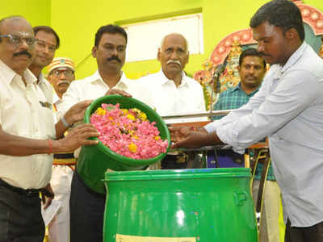
FACTORS AFFECTING SWM SYSTEM
Cultural constraints:
In some regions, long-standing traditions preclude the intrusion of waste collection on the precincts of households, and therefore, influence the collection system.
In others, where the tradition of caste persists, recruits to the labor force for street cleaning and handling of waste must be drawn from certain sections of the population.
Waste management should, therefore, be sensitive to such local patterns of living and consider these factors in planning, design and operation.
Fig: Madurai small temples successful flower waste management

Slide 67
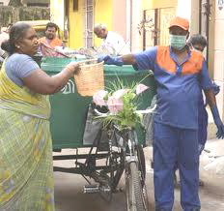
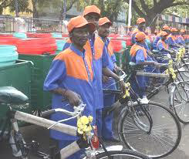
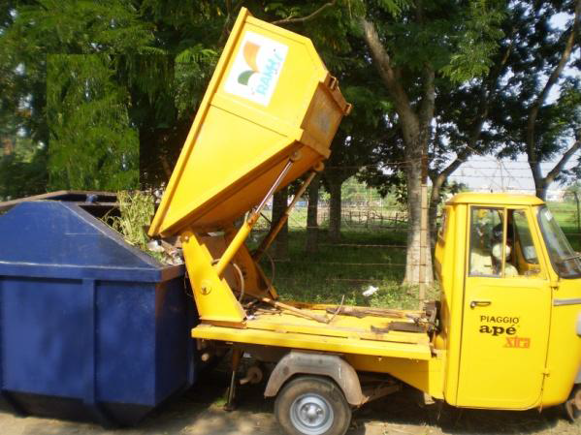
FACTORS AFFECTING SWM SYSTEM
Management and technical resources:
Solid waste management, to be successful, requires a wide spectrum of workforce in keeping with the demands of the system. The best system for a region is one which makes full use of indigenous crafts and professional skills

Slide 68
PROGRESS OF MSW MANAGEMENT IN INDIA
The problem of municipal solid waste management has acquired alarming dimensions in India especially over the last decade, before which waste management was hardly considered an issue of concern as the waste could be easily disposed of in an environmentally safe manner.
However, with time, due to changing lifestyles of people coupled with unplanned developmental activities, urbanization and industrialization, the waste quantity and characteristics have changed, and as a result, managing solid wastes has become difficult.

Slide 69
PROGRESS OF MSW MANAGEMENT IN INDIA
The physical and chemical characteristics of Indian city refuse, nonetheless, show that about 80% of it is compostable and ideal for biogas generation due to adequate nutrients (NPK), moisture content of 50-55% and a carbon-to-nitrogen ratio of 25-40:1.
Therefore, the development of appropriate technologies for utilization of wastes is essential to minimize adverse health and environmental consequences.
Waste quantum: The per capita waste generation rate is about 500 g/day. This along with increased population has contributed to higher total waste generation quantum

Slide 70
PROGRESS OF MSW MANAGEMENT IN INDIA
Waste composition: Studies reveal that the percentage of the organic matter has remained almost static at 41% in the past 3 decades, but the recyclables have increased from 9.56% to 17.18%
Waste disposal methods: Waste disposal is the final stage of the waste management cycle. About 90% of the municipal waste collected by the civic authorities in India is dumped in low-lying areas outside the city/town limits, which have no provision of leachate collection and treatment, and landfill gas collection and use.

Slide 71
PROGRESS OF MSW MANAGEMENT IN INDIA
Recycling: This involves collection of recyclables from various sources, which ultimately reach recycling units. It is estimated that about 40-80% of plastic waste gets recycled in India, as compared to 10-15% in the developed nations of the world.
However, due to lack of suitable government policies, incentives, subsidies, regulations, standards, etc., related to recycling, this industry is still far behind its western counterparts in terms of technology and quality of manufactured goods. Nevertheless, recycling in India is a highly organized and profit-making venture, though informal in nature.

Slide 72
PROGRESS OF MSW MANAGEMENT IN INDIA
Health impacts: Due to the absence of standards and norms for handling municipal wastes, municipal workers suffer occupational health hazards of waste handling.
Also, municipal workers and rag pickers who operate informally for long hours rummaging through waste also suffer from occupational health diseases ranging from respiratory illnesses (from ingesting particulates and bio-aerosols), infections (direct contact with contaminated material), puncture wounds (leading to tetanus, hepatitis and HIV infection) to headaches and nausea, etc.

Slide 73
PROGRESS OF MSW MANAGEMENT IN INDIA
Environmental impacts: In addition to occupational health, injury issues and environmental health also need to be mentioned in the context of waste management. Contaminated leachate and surface run-off from land disposal facilities affects ground and surface water quality.
The pneumonic plague that broke out in November 1994 in India (Surat, Gujarat) is a typical example of solid waste mismanagement.

Slide 74
PROGRESS OF MSW MANAGEMENT IN INDIA
In the project report as per the guidelines laid down in the manual on SWM are as follow:
Existing status of SWM the details of equipment machineries and infrastructures, are need to be studied.
Field study to carry out commercial, institutional and residential area garbage quantity before planning the system.
Complete physical characteristics of waste should be carried out for the garbage collected from a standard test laboratory.
Existing system of collection storage transportation processing under treatment shall be fully analyzed.
Justification for equipment and machinery required in order to ensure optimum utilization of the same.
Detailed design and drawing of proposed solid waste management system including landfills and best processing plant should be carried out for development of sanitary landfill.

Slide 75
PROGRESS OF MSW MANAGEMENT IN INDIA
Detailed design and drawing of proposed solid waste management system including landfills and best processing plant should be carried out for development of sanitary landfill.
Mechanism of operation and maintenance off equipment and machinery and its upkeep preventive maintenance on regular basis for existing equipment and machinery.
A routing plan for storage and collection of garbage based on the city layout.
Proposed institutional and financial reforms after completion of scheme.
Action plan for effective operation and maintenance imposition of user charges.
Details of suitable land for setting up integrated waste management facility in position including land for sanitary landfill.

Slide 76

SOLID WASTE MANAGEMENT SYSTEM
Solid waste management (SWM) is associated with the control of waste generation, its storage, collection, transfer and transport, processing and disposal in a manner that is in accordance with the best principles of public health, economics, engineering, conservation, aesthetics, public attitude and other environmental considerations.

Slide 77
SOLID WASTE MANAGEMENT SYSTEM
SWM processes differ depending on factors such as economic status (e.g., the ratio of wealth created by the production of primary products to that derived from manufactured goods, per capita income, etc.), degree of industrialization, social development (e.g., education, literacy, healthcare, etc.) and quality of life of a location. In addition, regional, seasonal and economic differences influence the SWM processes.
This, therefore, warrants management strategies that are economically viable, technically feasible and socially acceptable to carry out such of the functions as are listed
Protection of environmental health.
Promotion of environmental quality.
Supporting the efficiency and productivity of the economy.
Generation of employment and income.

Slide 78
SOLID WASTE MANAGEMENT SYSTEM
SWM has socio-economic and environmental dimensions. In the socio-economic dimension, for example, it includes various phases such as waste storage, collection, transport and disposal, and the management of these phases has to be integrated. In other words, wastes have to be properly stored, collected and disposed of by co-operative management.
In addition, poor management of wastes on the user side such as disposing of wastes in the streets, storm water drains, rivers and lakes has to be avoided to preserve the environment, control vector-born diseases and ensure water quality/resource.

Slide 79
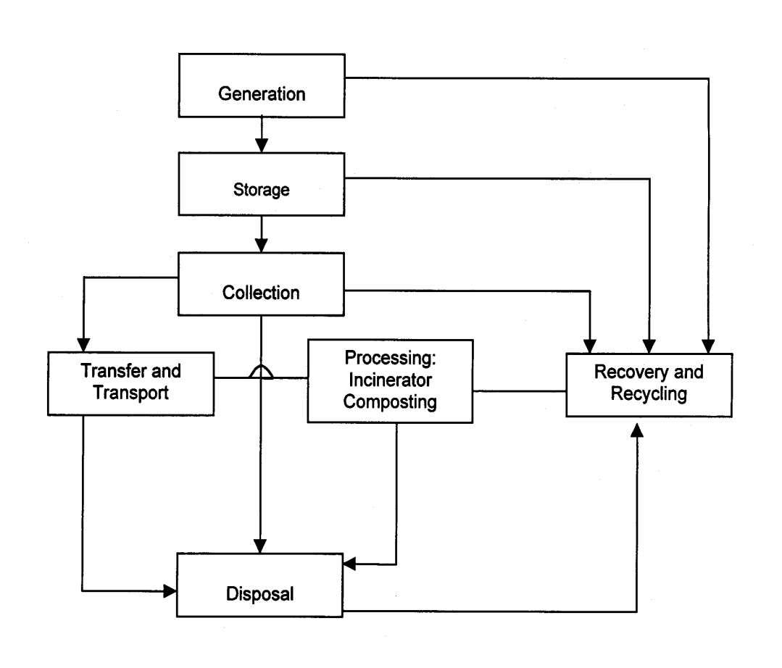
SOLID WASTE MANAGEMENT SYSTEM
Fig: Typical SWM System: Functional Elements

Slide 80
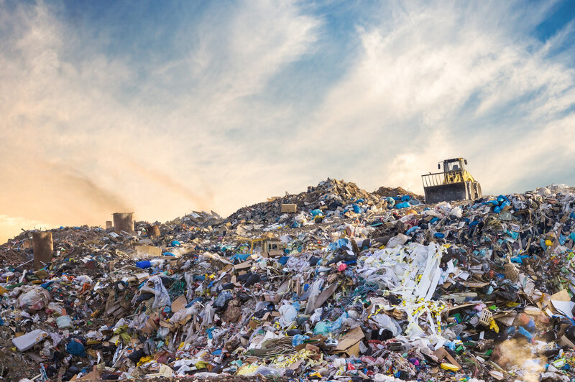
SOLID WASTE MANAGEMENT SYSTEM
Waste generation: Wastes are generated at the start of any process, and thereafter, at every stage as raw materials are converted into goods for consumption.
The source of waste generation, determines quantity, composition and waste characteristics. For example, wastes are generated from households, commercial areas, industries, institutions, street cleaning and other municipal services. The most important aspect of this part of the SWM system is the identification of waste.
Fig: Waste generation

Slide 81
SOLID WASTE MANAGEMENT SYSTEM
Waste storage: Storage is a key functional element because collection of wastes never takes place at the source or at the time of their generation.
The heterogeneous wastes generated in residential areas must be removed within 8 days due to shortage of storage space and presence of biodegradable material. Onsite storage is of primary importance due to aesthetic consideration, public health and economics involved.
Some of the options for storage are plastic containers, conventional dustbins (of households), used oil drums, large storage bins (for institutions and commercial areas or servicing depots), etc.

Slide 82
SOLID WASTE MANAGEMENT SYSTEM
Waste collection: This includes gathering of wastes and hauling them to the location, where the collection vehicle is emptied, which may be a transfer station (i.e., intermediate station where wastes from smaller vehicles are transferred to larger ones and also segregated), a processing plant or a disposal site.
Collection depends on the number of containers, frequency of collection, types of collection services and routes. Typically, collection is provided under various management arrangements, ranging from municipal services to franchised services, and under various forms of contracts.

Slide 83
SOLID WASTE MANAGEMENT SYSTEM
Transfer and transport: This functional element involves:
The transfer of wastes from smaller collection vehicles, where necessary to overcome the problem of narrow access lanes, to larger ones at transfer stations;
The subsequent transport of the wastes, usually over long distances, to disposal sites.
Processing: Processing is required to alter the physical and chemical characteristics of wastes for energy and resource recovery and recycling. The important processing techniques include compaction, thermal volume reduction, manual separation of waste components, incineration and composting.

Slide 84
SOLID WASTE MANAGEMENT SYSTEM
Recovery and recycling: This includes various techniques, equipment and facilities used to improve both the efficiency of disposal system and recovery of usable material and energy. Recovery involves the separation of valuable resources from the mixed solid wastes, delivered at transfer stations or processing plants.
It also involves size reduction and density separation by air classifier, magnetic device for iron and screens for glass. The selection of any recovery process is a function of economics, i.e., costs of separation versus the recovered-material products. Certain recovered materials like glass, plastics, paper, etc., can be recycled as they have economic value.

Slide 85
SOLID WASTE MANAGEMENT SYSTEM
Waste disposal: Disposal is the ultimate fate of all solid wastes, be they residential wastes, semi-solid wastes from municipal and industrial treatment plants, incinerator residues, composts or other substances that have no further use to the society.
Thus, land use planning becomes a primary determinant in the selection, design and operation of landfill operations. A modern sanitary landfill is a method of disposing solid waste without creating a nuisance and hazard to public health.
Generally, engineering principles are followed to confine the wastes to the smallest possible area, reduce them to the lowest particle volume by compaction at the site and cover them after each day’s operation to reduce exposure to vermin. One of the most important functional elements of SWM, therefore, relates to the final use of the reclaimed land.

Slide 86
Youtube Links
biomethanation process -
https://www.youtube.com/watch?v=Hso54zFOuVY
https://www.youtube.com/watch?v=-iYpPzeG7fI
Sampling Methods
https://www.youtube.com/watch?v=Y9mYIs8NWGc
https://www.youtube.com/watch?v=S_8gFOhRj_c
Zero MSW countries
San fransisco - https://www.youtube.com/watch?v=Cg3OA1s8-SI
Singapore - https://www.youtube.com/watch?v=HYKANHHiBLs
https://www.youtube.com/watch?v=Ztjlo0epmeY

